Slide 1
Nordic Polymer Days 2013
Truly Nordic
Svenska Kemistsamfundets Polymerdagar 1963 organized by Prof. Bengt Rånby
15 Presentations from Sweden
2 Presentations from USA
1 Presentation from Denmark by a graduate student named Charles M. Hansen
The “Nordic” requirement, presentations from at least two Nordic countries, was fulfilled.

Slide 2
UNDERSTANDING ABSORPTION IN POLYMERS:
KEY TO IMPROVING BARRIER PROPERTIES NORDIC POLYMER DAYS 2013 HELSINKI
Charles M. Hansen, Actively Retired
Mismatch Hansen solubility parameters to get
1. Lower equilibrium absorption, and therefore:
A. Lower concentration gradients
B. Lower diffusion coefficients
C. Lower surface mass transfer coefficients
and
Better Barriers

Slide 3
The Message is:
The Diffusion Equation is Valid
1963: Drying of solvent from polymer
2013: Sorption of solvent by polymer
Exactly the same equations and data can be used to satisfactorily model desorption (film formation) and absorption, as well as permeation.
There are no ”Anomalies” in absorption!
Stress related effects are not (that) signficant

Slide 4
OUTLINE
Laws of Diffusion
Find correct diffusion coefficients
Concentration dependent coefficients
Surface condition can be significant
Combine these to:
1. Model film formation by solvent evaporation
2. Model ”anomalies” of absorption

Slide 5
FICK’S FIRST AND SECOND LAWS
Law 1: F = - D₀(∂c/∂x)
For mass transport in the x Direction, and
Law 2: ∂c/∂t = ∂/∂x (D₀∂c/∂x)
This is also called the Diffusion Equation.
(Accumulation equals flux in minus flux out)

Slide 6
DIMENSIONLESS VARIABLES
Dimensionless time:
T = D₀t/L² (cm²/s)(s/cm²)
Dimensionless distance:
X = x/L
Dimensionless concentration:
C = (c – c₀)/(c∞ - c₀)
L is the thickness of a free film

Slide 7
MEASURING DIFFUSION COEFFICIENTS
Half-time (t_{½}) equation for measuring D₀
Corrections required for concentration
dependence (M) and surface resistance (B)
See also Nordtest POLY 188
D₀ = 0.049 L²/t_{½}

Slide 8
CORRECTIONS FOR CONCENTRATION DEPENDENCE ALONE
Note huge corrections for desorption
Desorption Absorption
D_{max}/D₀ (F_{d})_{1/2} (F_{d})_{1/4} (F_{a})_{1/2}
1 1.00 1.00 1.00
2 1.56 1.55 1.30
5 2.70 2.61 1.70
10¹ 4.00 3.84 2.01
10² 13.40 10.20 3.30
10³ 43.30 23.10 4.85
10⁴ 138.7 47.40 6.14
10⁵ 443.0 89.0 7.63
10⁶ 1,370.0 160.5 8.97
10⁷ 4,300.0 290.0 10.60
10⁸ 13,670.0 506.0 12.10

Slide 9
SURFACE CONDITION
F_{s} = h(C^{eq} – C_{s}) = -D_{s}∂C_{s}/∂x
  Flux through surface to(from) external phase equals flux through surface from(to) the bulk.
  External Flux to/from surface, F_{s}, equals mass transfer coefficient, h, (cm/s) times concentration difference, g/cm³ giving g/cm²s
  Flux to/from bulk equals diffusion coefficient (cm²/s) times concentration gradient (g/cm³cm)
  h can be found from h = F_{s} /(C^{eq} – C_{s}) @ t = 0

Slide 10
CORRECTIONS FOR SURFACE RESISTANCE FOR D₀ = CONST.
B = hL/D₀ = R_{d}/R_{s}
B 1/B F_{B}
∞ 0 1.0
10 0.1 1.45
2 0.5 3.14
1 1 4.95
0.5 2 6.8
0.1 10 37.5

Slide 11
EXPONENTIAL DIFFUSION COEFFICIENTS FOR CHLOROBENZENE IN POLY(VINYL ACETATE)
The system chlorobenzene in poly(vinyl acetate) has been studied extensively with all relevant data reported in my thesis and subsequent journal articles. These data give a coherent understanding of diffusion in polymers including: Absorption data from one equilibrium to another Desorption data from different equilibrium values to vacuum, and film drying (years), but
only
if one accounts for concentration dependence and significant surface effects when present.

Slide 12
D(c) FOR CHLOROBENZENE IN PVAc FOR ALL CONCENTRATIONS (HANSEN, 1967)

Slide 13
DRYING OF A LACQUER FILM (Hansen, 1963, 1967, 1968)

Slide 14
RELATIVE SOLVENT RETENTION (HANSEN, 1967)
MOLECULAR SIZE AND SHAPE

Slide 15
DESORPTION AND ABSORPTION GIVE SAME D(c) WITH CORRECTION (HANSEN 1967, 2007)

Slide 16
ABSORPTION WITH CORRECTIONS
(F_{a}) REQUIRED FOR D(c) AND F_{B} FOR R_{s}

Slide 17
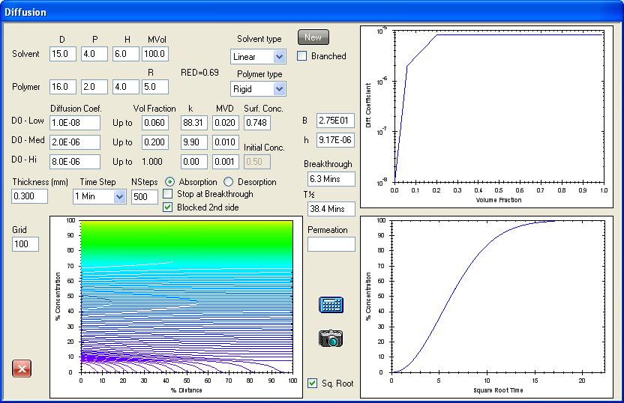
Data: Hasimi et al. Eur.Polym.J. 2008;44:4098-4107 ABSORPTION OF WATER VAPOR INTO PVAlc FROM BONE DRY TO 0.748 VOLUME FRACTION

Slide 18
POTENTIALLY SIGNIFICANT SURFACE EFFECTS IN VAPOR ABSORPTION
External phase diffusion from source to film
Diffusion in stagnant boundary layer at film
Heat removal on condensation
Adsorption (How well do HSP match?)
Orientation (Does n-hexane enter sideways?)
Absorption site (hole size and shape)
Transport into bulk (Diffusion coefficient, molecular size and shape)

Slide 19
SURFACE RESISTANCE FOR LIQUID CONTACT COC POLYMER TOPAS® 6013 TICONA (NIELSEN, HANSEN 2005)

Slide 20
S-SHAPED CURVES CAUSED BY SURFACE RESISTANCE (NIELSEN, HANSEN 2005)

Slide 21
Apparent h and Equilibrium Uptake for COC Topas® 6013 on Liquid Contact
Solvent Apparent h, cm/s Equilibrium uptake, vol. fraction
Tetrahydrofuran 1.89(10)⁻⁴ 0.676
Hexane 7.78(10)⁻⁶ 0.351
Diethyl ether 1.21(10)⁻⁶ 0.268
Propylamine 1.49(10)⁻⁷ 0.181
Ethylene dichloride 1.18(10)⁻⁷ 0.176
Ethyl acetate 1.46(10)⁻⁸ 0.076
n-Butyl acetate 8.30(10)⁻¹⁰ 0.202
Phenyl acetate 0 0
Acetophenone 0 0
1,4-Dioxane 0 0
Tetrahydrofuran apparent h is too low since diffusion controls.
n-Butyl acetate apparent h is strongly lowered by size and shape.

Slide 22
Surface Mass Transfer COC (Topas® 6013) Depends On Equilibrium Absorption. Equilibrium Absorption depends on ΔHSP

Slide 23
MAJOR REFERENCES EXPLAINING “ANOMALIES” USING DIFFUSION EQUATION
Chapter 16 of Second Edition of Hansen Solubility Parameters: A User’s Handbook, CRC Press, 2007.
Hansen CM. The significance of the surface condition in solutions to the diffusion equation: explaining "anomalous" sigmoidal, Case II, and Super Case II absorption behavior. Eur Polym J 2010;46;651-662.
Abbott S, Hansen CM, Yamamoto H. Hansen Solubility Parameters in Practice, www.hansen-solubility.com. (includes software for absorption, desorption and permeation)
Downloads on www.hansen-solubility.com. Including this presentation with comments

Slide 24
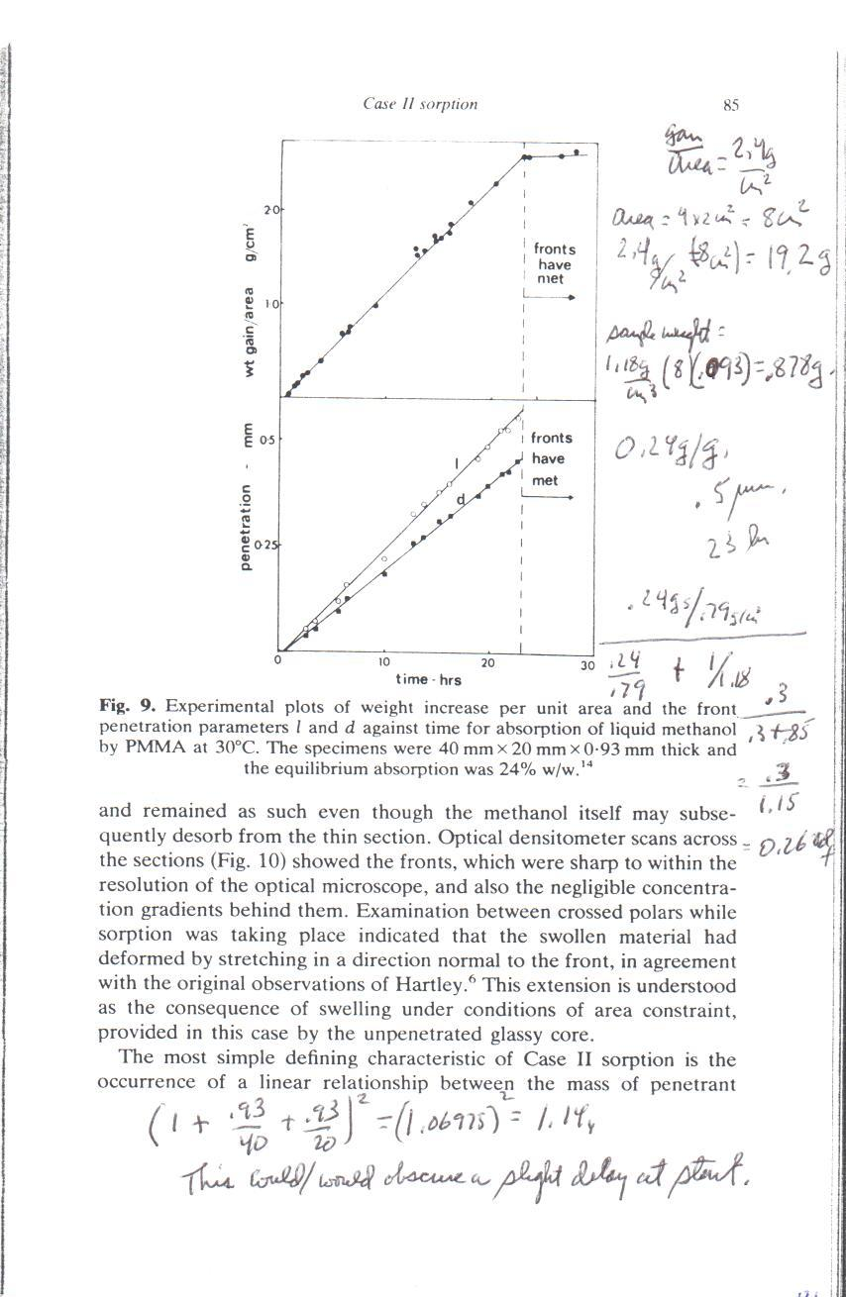
Thomas and Windle Case II Example
Methanol/PMMA with Iodine Tracer
Straight line absorption
with linear time cited as
excellent example of
Case II behavior.
This result is duplicated:
Diffusion equation with
significant surface effect
and exponential D(c)

Slide 25
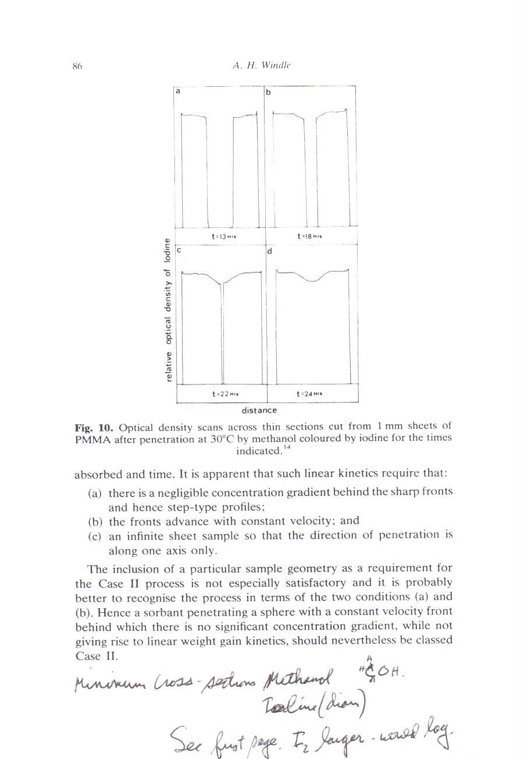
Thomas and Windle Case II Example
Windle, “Case II Sorption” in Comyn, Polymer Permeability (1985)
Iodine tracer lags methanol
in PMMA at 30°C showing
apparent step-like gradient.
Methanol does not have this
“advancing sharp front”.
Iodine tracer is far too slow
as shown in the following.
Methanol gradients become
horizontal, not vertical.

Slide 26
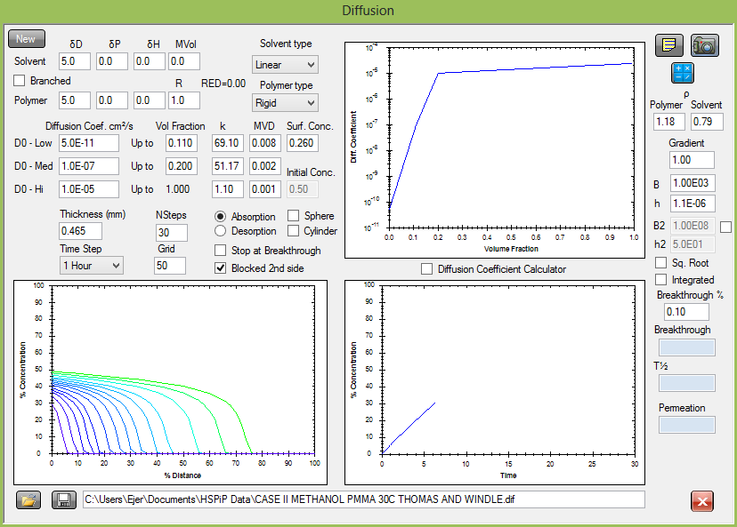
THOMAS AND WINDLE EXPERIMENT 6.3 HOURS

Slide 27
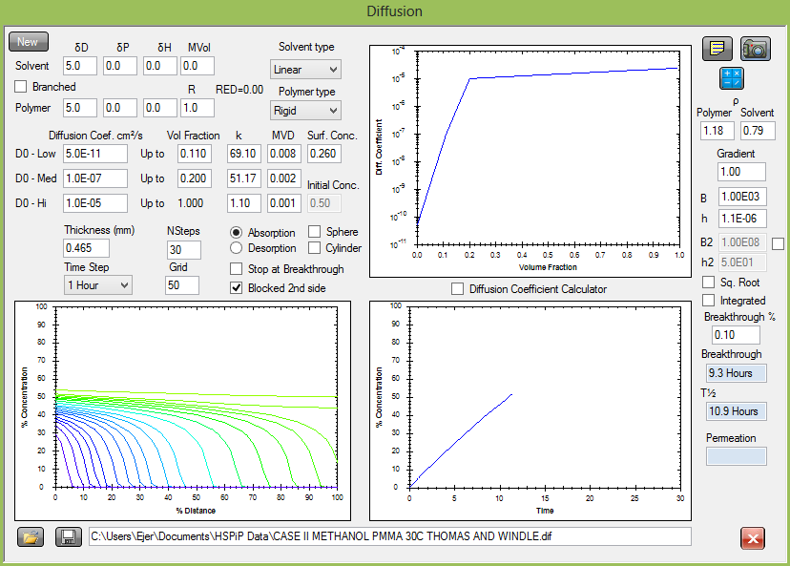
THOMAS AND WINDLE EXPERIMENT 11.3 HOURS

Slide 28
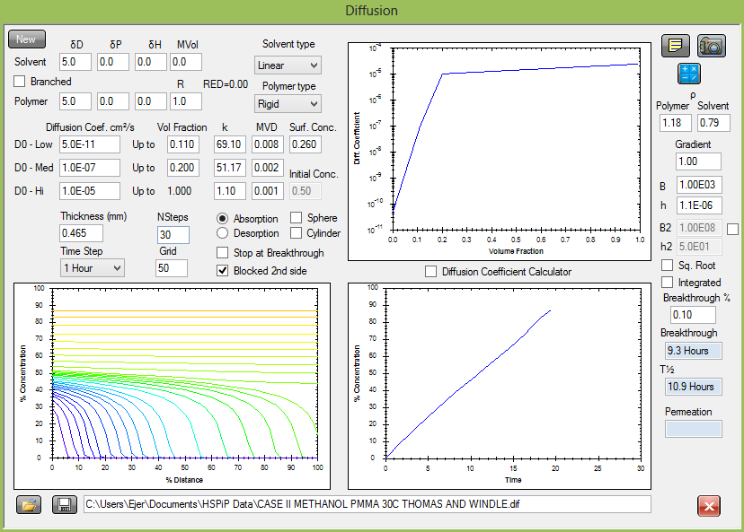
THOMAS AND WINDLE EXPERIMENT 19.3 HOURS

Slide 29
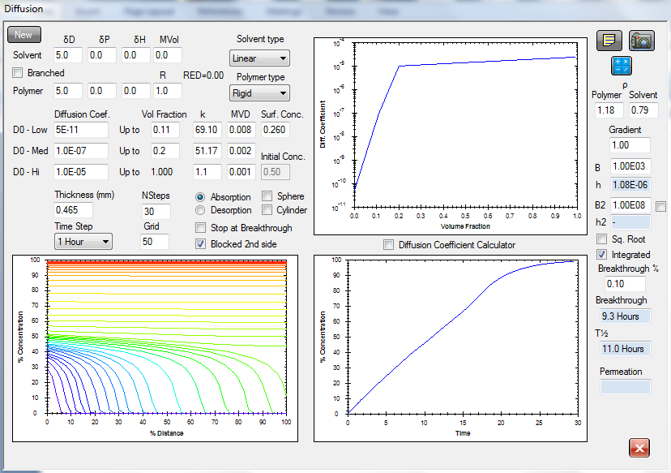
Methanol/PMMA Absorption at 30ºC
Calculated Concentration Gradients Flat at 13 hours

Slide 30
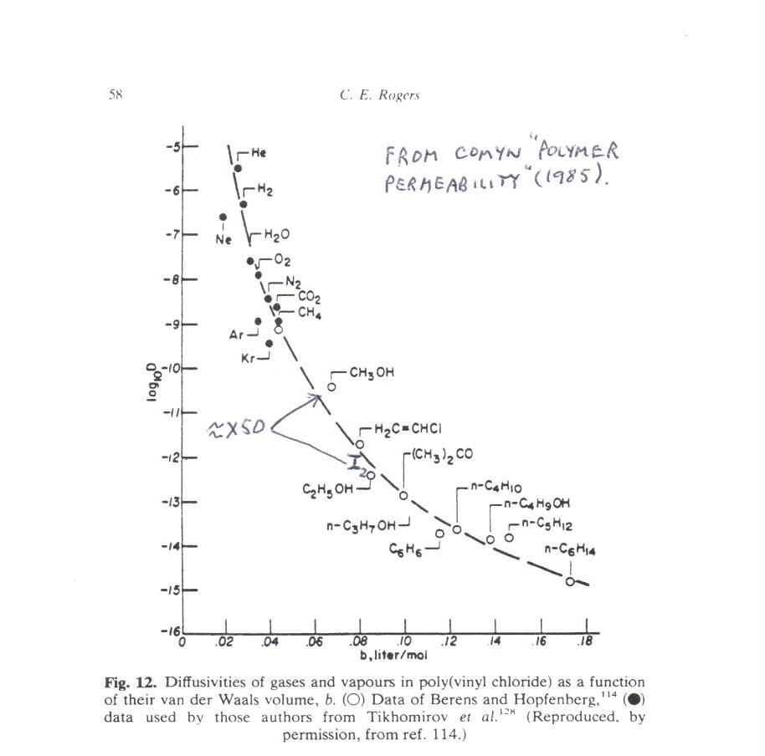
Effect of Molecular Properties on D₀
Compare Methanol with Iodine

Slide 31
Super Case II: n-Hexane/Polystyrene Hopfenberg and Coworkers

Slide 32
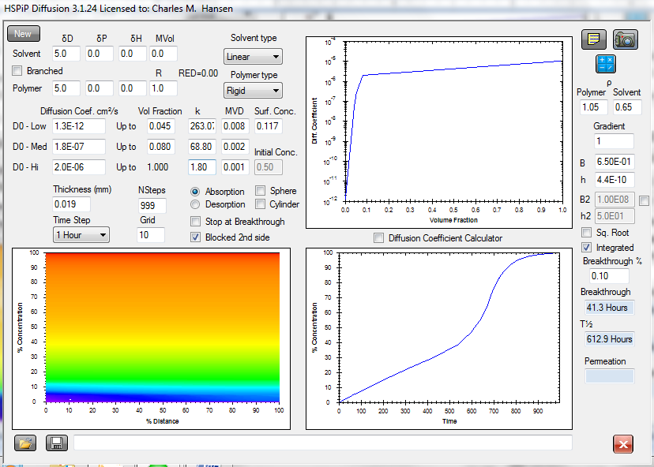
Hopfenberg and Coworkers Super Case II
Correctly Modeled Absorption, D₀, and h.

Slide 33
HANSEN IS “EXTRANEOUS”: PETROPOULOS et.al
Hansen is extraneous; challenges included
Petropoulos JH Sanopoulou M Papadokostaki KG.
Physically insightful modeling of non-Fickian kinetic energy regimes encountered in fundamental studies of isothermal sorption of swelling agents in polymeric media.
Eur Polym J 2011;47:2053-2062.

Slide 34
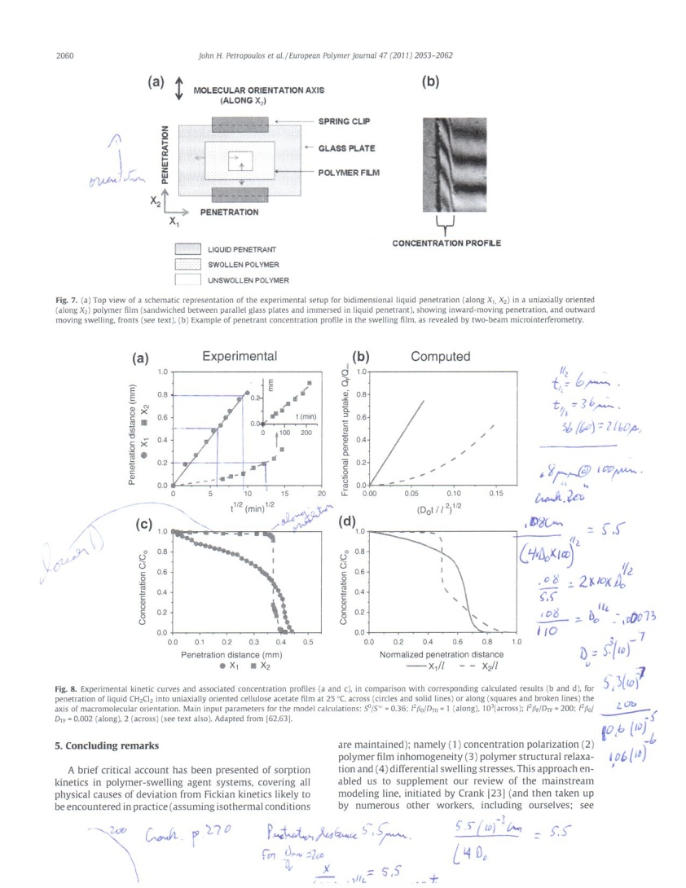
Hansen cannot explain these data!
Next two slides do explain these data for liquid dichloromethane absorption into stretched, confined Cellulose Acetate

Slide 35
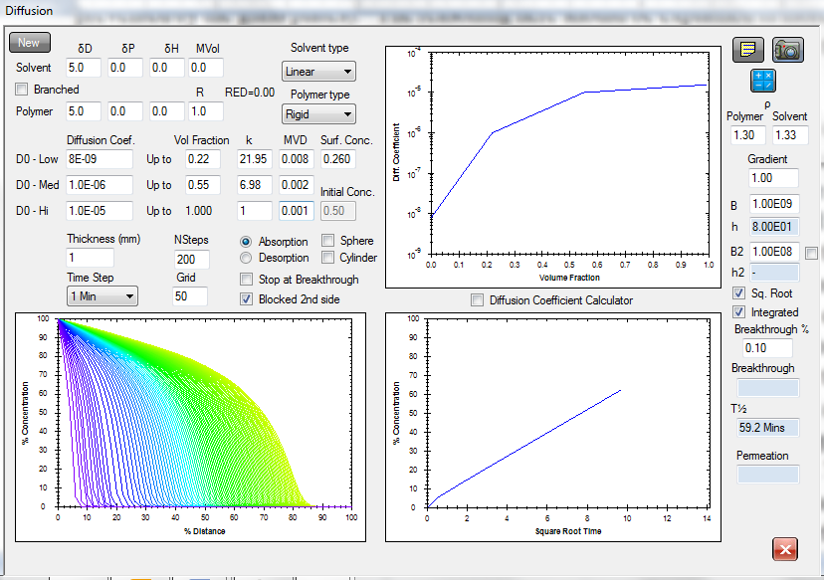
CALCULATED ABSORPTION CURVE AND GRADIENTS MATCH EXPERIMENTAL DATA FOR ABSORPTION PERPENDICULAR TO STRETCH DIRECTION: METHYLENE CHLORIDE IN CELLULOSE ACETATE.

Slide 36
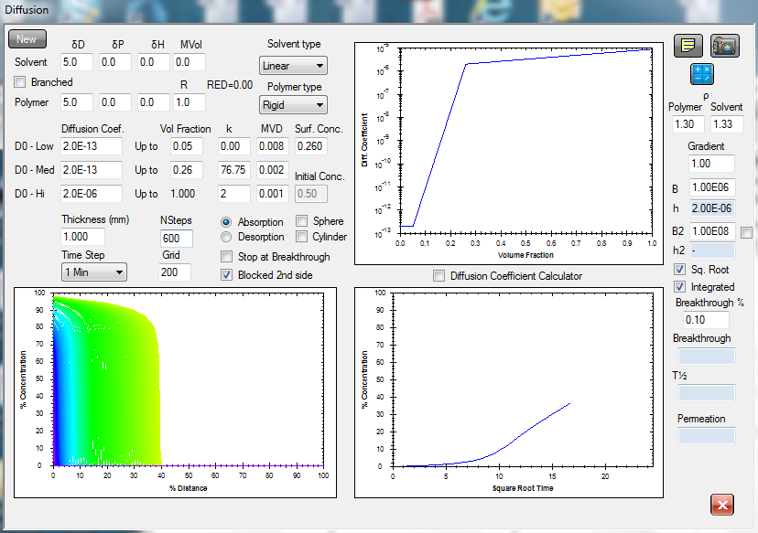
CALCULATED ABSORPTION CURVE IS PERFECT, FRONT NOT A SHARP STEP, BUT CLOSE TO EXPERIMENTAL. METHYLENE CHLORIDE IN STRETCH DIRECTION.
ARE INITIAL CONDITIONS MAINTAINED? CHANNELS?

Slide 37
POTENTIALLY SIGNIFICANT SURFACE EFFECTS IN (LIQUID) ABSORPTION
Adsorption (How well do HSP match?)
Polymer rotation to match HSP of external phase: reason for success with a constant h?
Orientation (Does n-hexane enter sideways?)
Absorption site (hole size and shape)
Number of absorption sites (Equilibrium uptake and similarity of HSP)
Transport into bulk (Diffusion coefficient, molecular size and shape)

Slide 38
CONCLUSION:
STRESS RELAXATION NEED NOT BE INVOKED.
Exclusively bulk phenomena such as stress relaxation or swelling stress need not be invoked to explain the cases examined including Thomas and Windle Case II, Super Case II, and Sigmoidal examples, or the studies of Petropoulos and coworkers.
The diffusion equation can fully describe all of these studies and those of Hansen when the a significant surface condition is included and exponential diffusion coefficients are used.

Slide 39
SUMMARY
Laws of Diffusion are Valid
Exponential Diffusion Coefficients
Surface Condition involved with ”Anomalies”
Combine These - No Anomalies
Exclusively Bulk Explanations not possible
Estimate Behavior at Different Conditions
Improved understanding and modeling of absorption, desorption, and permeation
Improve Barriers with (HSP_{p} ≠ ≠ HSP_{s})

Slide 40

Thank you for your attention!
For further contact please visit:
www.hansen-solubility.com

Slide 41
PERMEATION WITH SURFACE AND/OR EXTERNAL RESISTANCES
F = Δp/(L/P_{app}) = Δp/(L/P∞ + R₁ + R₂ + R₃ …)
L/P_{app} = L/P∞ + R₁ + R₂ + R₃ ….
1/P_{app} = 1/P∞ + (R₁ + R₂ + R₃ ….)/L
Use Plot of 1/P∞ Versus 1/L

Slide 42
TRUE PERMEATION COEFFICIENT (P∞)
BY EXTRAPOLATION (ACRYLIC FILMS)

Slide 43
DIFFUSION SIDE EFFECTS
Film: Thickness (L), length (l), width (w)
D₀ = D_{app} /(1 + L/l + L/w)²
Circular Film: Thickness (b), Radius (R)
D₀ = D_{app}/(1 + b/R)²
For L = 1mm and w = 10mm: D_{app}/D₀ = 1.21
Tensile bars (L = 2-4mm, w=10mm): Do not use!

Slide 44
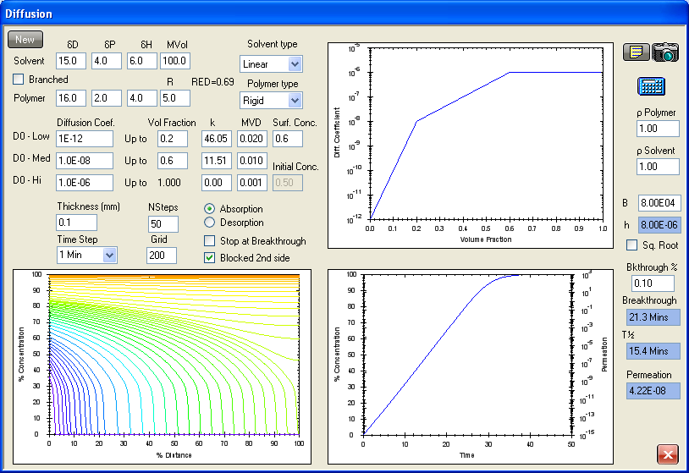
CASE II ABSORPTION WITH LINEAR UPTAKE WITH LINEAR TIME. THE SURFACE CONCENTRATION INCREASES SLOWLY

Slide 45
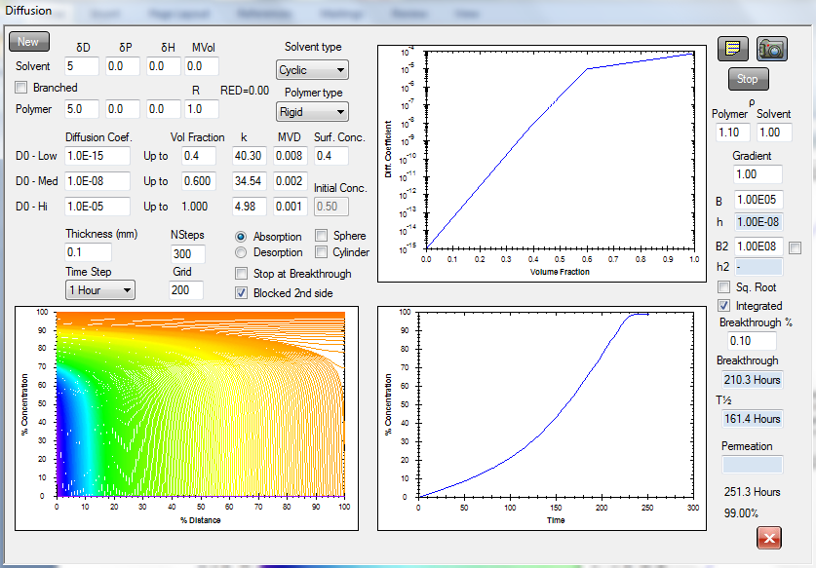
SUPER CASE II WITH SLOWLY INCREASING RATE OF ABSORPTION WITH TIME. CONCENTRATION GRADIENTS SHOW A FRONT.

Slide 46
WHOLE EQUALS SUM OF PARTS
E = COHESION ENERGY = ΔEvap
E = E_{D} + E_{P} + E_{H}
D - Dispersion (Hydrocarbon)
P - Polar (Dipolar)
H - Hydrogen Bonds (Electron Interchange)
V - Molar Volume
E/V = E_{D}/V + E_{P}/V + E_{H}/V
  δ² = δ²_{D} + δ²_{P} + δ²_{H}
  HANSEN SOLUBILITY PARAMETERS (HSP)
  δ = Square Root of Cohesion Energy Density

Slide 47
KEY EQUATIONS
Ra² = 4(δ_{D1} - δ_{D2})² + (δ_{P1} - δ_{P2})² + (δ_{H1} - δ_{H2})²
The experimentally verified ”4” is also found in Prigogine’s CST theory
RED = Ra/Ro (Distance to sphere center divided by its radius)
(RED)² = (Ra/Ro)² corresponds to ^{χ}₁₂ ^{/ χ}_{c} in Huggins/Flory Theory

Slide 48
FREE ENERGY CHANGE, G, DETERMINES SOLUBILITY OR NOT
Free energy G must be negative for solution
G = (1/N)øln(ø) + (1 - ø)ln(1 - ø) + Χø(1 - ø)
ø is the solvent volume fraction
N is the number of monomers in chain
Χ = V_{m}/RT[(δ_{D1} - δ_{D2})² + 0.25(δ_{P1} - δ_{P2})² + 0.25(δ_{H1} - δ_{H2})² ]
Χ is the chi parameter, V_{m} is the molar volume

